Slide 1




Usines logicielles:
Fondements et applications pour les lignes de produits logiciels
Mathieu Acher, Philippe Collet, Philippe Lahire

Slide 2

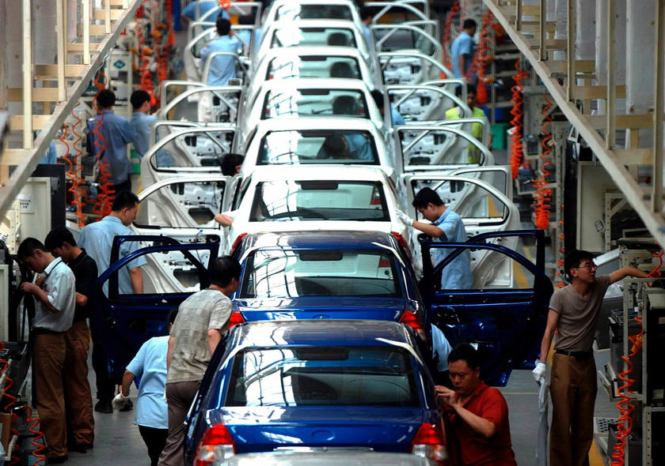



What this is all about
Software
Product
Lines
Large systems of systems
Large software systems
Composition /
decomposition
Variability models

Slide 3





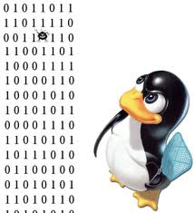


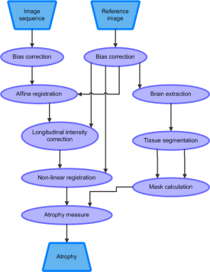
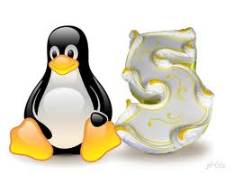
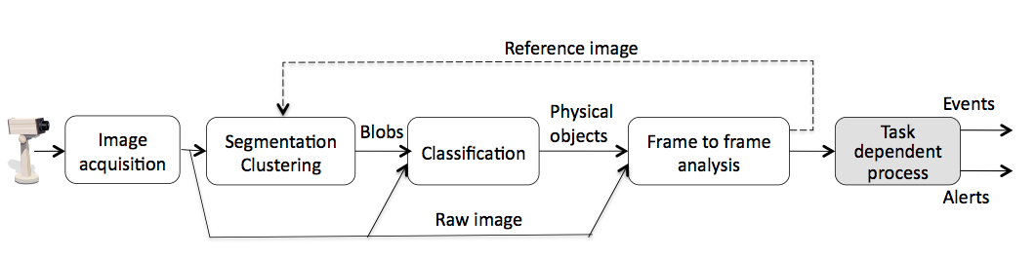
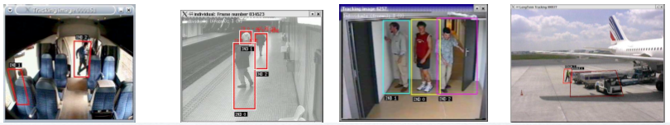
Software Product Line Engineering
Factoring out commonalities
for Reuse
Managing variabilities
for Software Mass Customization

Slide 4




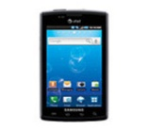
Domain engineering (development for reuse)
C++
UML
Ws
Common assets
Variants
Feature Model
Reusable Assets
(e.g., models or source code)
Feature Configurations
product₁
product₂
product_{n}
Feature Configuration
Application engineering (development with reuse)

Slide 5
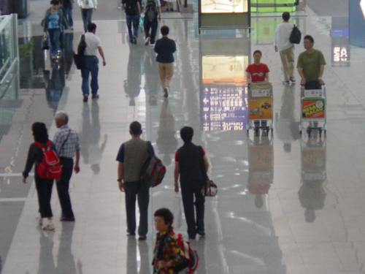
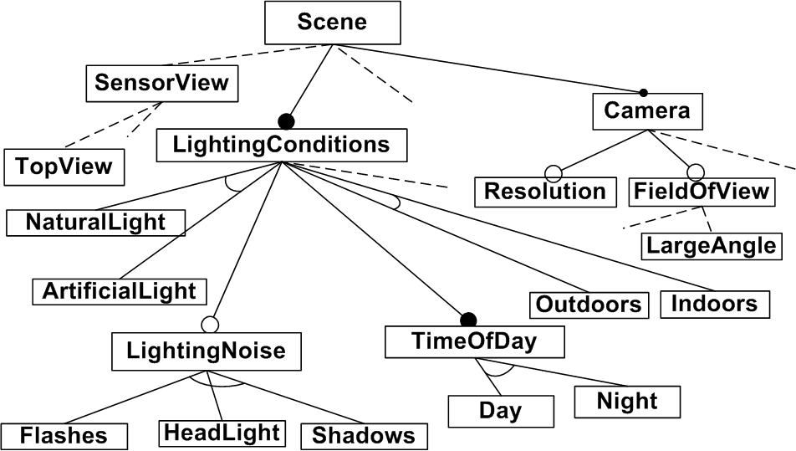
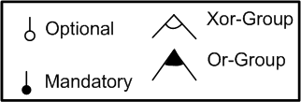
Feature Modeling
Widely used
Formal Semantics
  Propositional formula (^, v, ~, ⬄, =>)
Automated Reasoning Techniques
  Satisfiability, configuration checking…
Tools
  Language, editors...

Slide 6
Composition of Feature Models
Issue
  How to manage large, complex and multiple feature models
Solution
  Apply Separation of Concerns
  Provide a set of composition / decomposition operators
  Ground the operators on a sound basis (semantic not syntactic)
  Reuse / extend automated reasoning techniques

Slide 7
Composition operators
Insertion, aggregation, merge (union, intersection)
Slice (= projection)
Resulting support
  Well-defined semantics
  Guaranteeing semantic properties by construction (configuration set)
  Producing more compact feature models
  Efficiently implemented (good scalability w.r.t. existing techniques)
=
slice
=

Slide 8


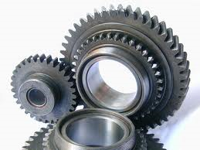

Domain Specific Language
// foo.fml
fm1 = FM (“foo1.tvl”)
fm2 = FM (“foo2.m”)
fm3 = merge intersection { fm1 fm2 }
c3 = counting fm3
renameFeature fm3.TV as “OutputTV”
fm5 = aggregate { fm3 FM (“foo4.xml”) }
assert (isValid fm5)
fm6 = slice fm5 including fm5.TV.*
export fm6
FAMILIAR
True/False
8759
“OutputTV”, “TV”
Interoperability
Language facilities
Environment

Slide 9
Composing Multiple Variability Artifacts to Assemble Coherent Workflows
The case of medical imaging workflows

Slide 10
Results
Multi-step process
  Specification of variability concerns
    FAMILIAR as an embedded language
  Catalog of reusable services
    Building and querying a catalog of feature models
  Automated reasoning techniques
    Propagation choices, updating feature model views
    FAMILIAR as a target language
First experimental results
  3 real scientific workflows
  Better user assistance and degree of automation
Updating
Updating
10

Slide 11

Modeling Variability From Requirements to Runtime
The case of video surveillance processing chains
large number of software configurations
Adaptive systems
for a large number of requirements
Collaboration with Sabine Moisan and Jean-Paul Rigault (INRIA)

Slide 12
Results
Separation of Concerns
  Software variability is distinguished from requirements variability
A systematic approach to specify and reason about variability of adaptive systems
  Variability requirements are step-wised specified at design time
    Some variability choices are kept for runtime adaptation (e.g., Day/Night)
  Reduction of software configurations to be considered at runtime
Reasoning operations
  Consistency checking
  “Reachability” property
    for all valid requirements (e.g., contexts), there exists at least one valid software configuration
  Specialization checking
  Choices Propagation
Language support
  aggregate + slice + compare + editing facilities
  Reuse of feature models and analysis procedures in 6 scenarios

Slide 13
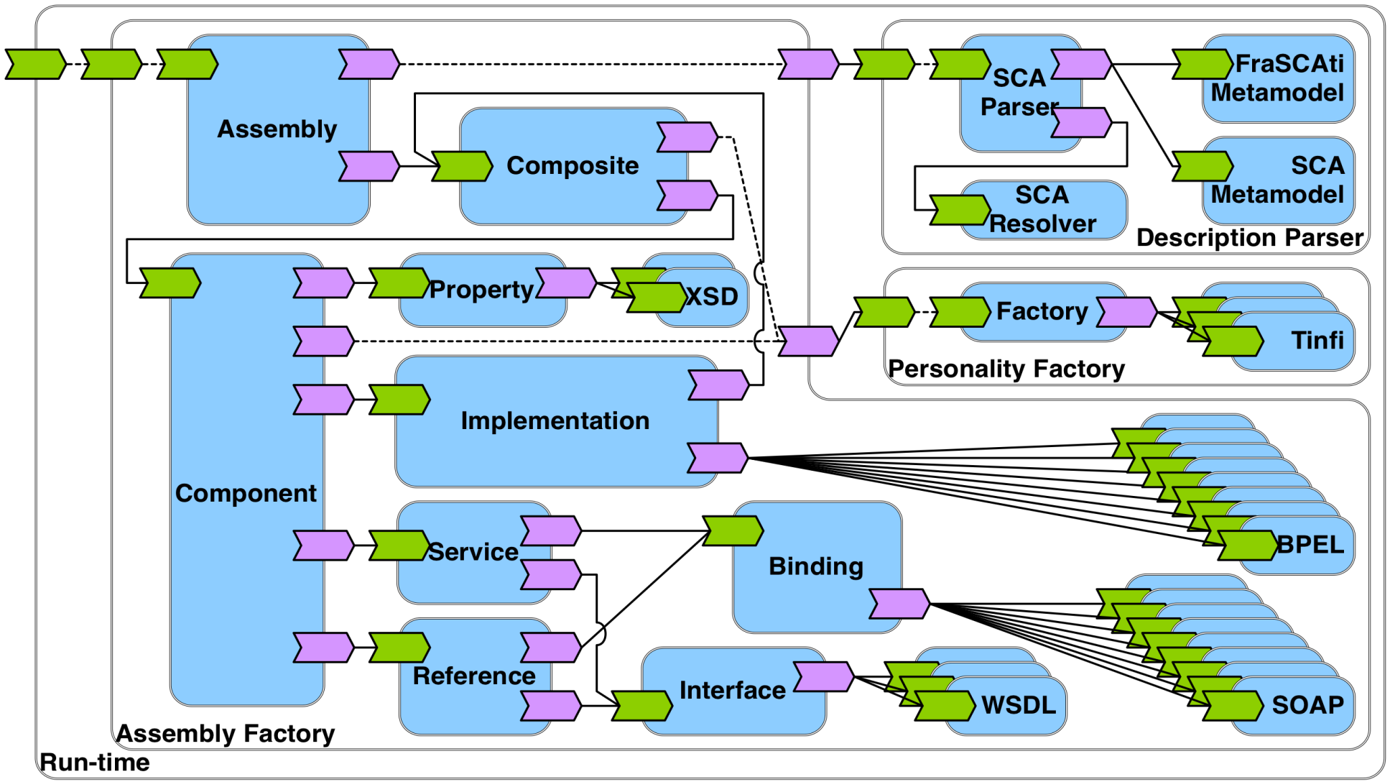
Reverse Engineering Architectural Feature Models
Case Study: FraSCAti Architecture
Collaboration with Anthony Cleve (University of Namur / PRECISE, Belgium),
Philippe Merle and Laurence Duchien (University of Lille / INRIA)

Slide 14
Results
Automated Procedure
  Extracting and combining variability sources
    FAMILIAR as a target language
Integration of software architect knowledge
  Reconciliation process
    Interactive process with FAMILIAR
Extensive use of operators
  aggregate, slice, merge, compare, editing facilities
  Reverse engineering process impossible without the operators
Lessons Learned
  Extraction procedure yields promising results
  Essential role of software architect
    To validate the extracted feature model
    To integrate knowledge

Slide 15

Questions

